Slide 1

Welcoming Year 5 Parents 2023-2024.

Slide 2

Homework Expectations
Homework-
reading including signing the reading records 20 minutes per night
Times table activity each week Times Table Rockstars
spellings sent home each week. Sentences to be written on sheets.
An additional activity to be completed when allocated.
Homework will be set on a Monday and will be collected on a Friday morning.

Slide 3

-Uniform- school and PE kit.
Full uniform list as per the school handbook.
Trainers on PE days and full PE kit.
Please name everything.
No earrings to be worn on PE days please.
Girls’/ Boys’ hair tied up for PE lessons.
Ensure all inhalers are in school.

Slide 4
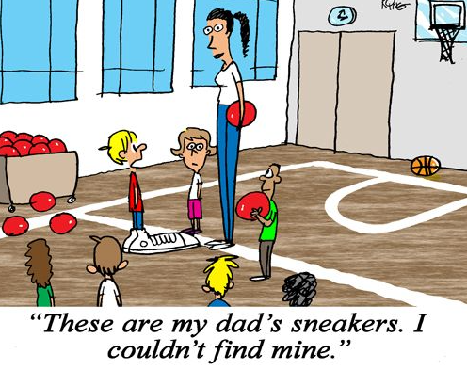
PE Days
Both Year 5 classes have PE on a Monday
5M has a second lesson on a Thursday and 5H on a Thursday.
The second lesson will be dance

Slide 5

School Equipment
Children are requested to bring in basic equipment such as pencils, a clear, plastic ruler, a rubber and a glue stick.

Slide 6


Lunch and snack
snack should be healthy, preferably fruit.
no crisps for snack time.
We are a nut free school, so no nuts in spreads or whole nuts.
Please provide a bottle containing water.
A small juice or water can be drunk during lunch.
No fizzy drinks.

Slide 7

Communication during
If you have any concerns about your child, please speak to me first.
admin via email or phone if urgent
admin@firsttower.sch.je

